Slide 1
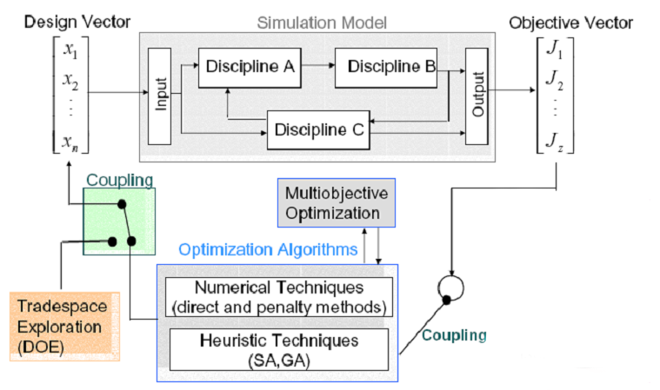
Advanced Design Methods - AE4233
Introduction to Optimization Techniques
Dries Visser

Slide 2
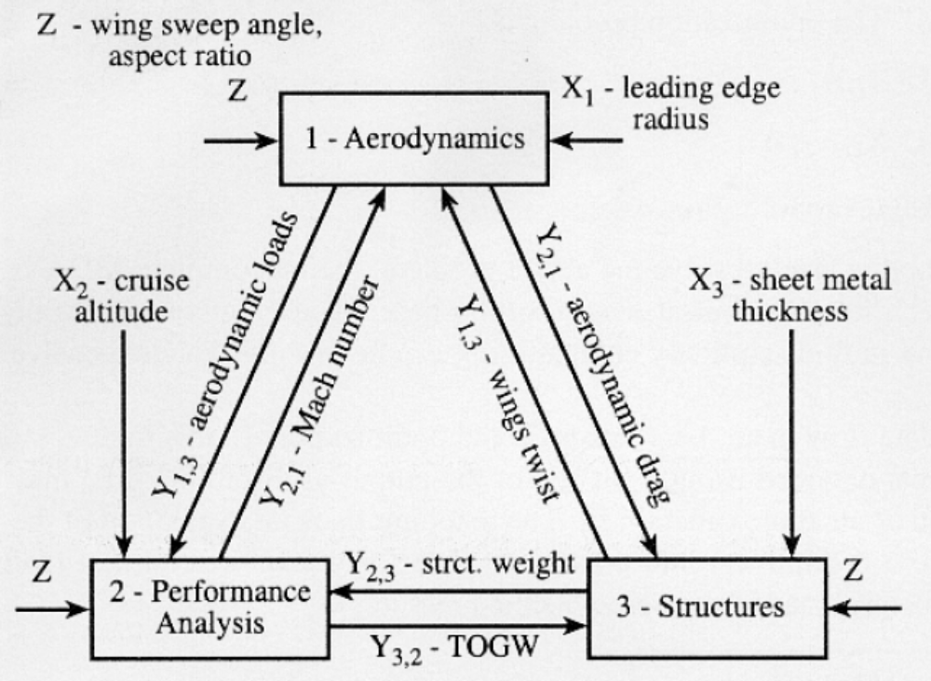
MDO example
Z = system-wide
design variable
X_{l} = local design
variable
Y_{i,j} = coupling
variable

Slide 3
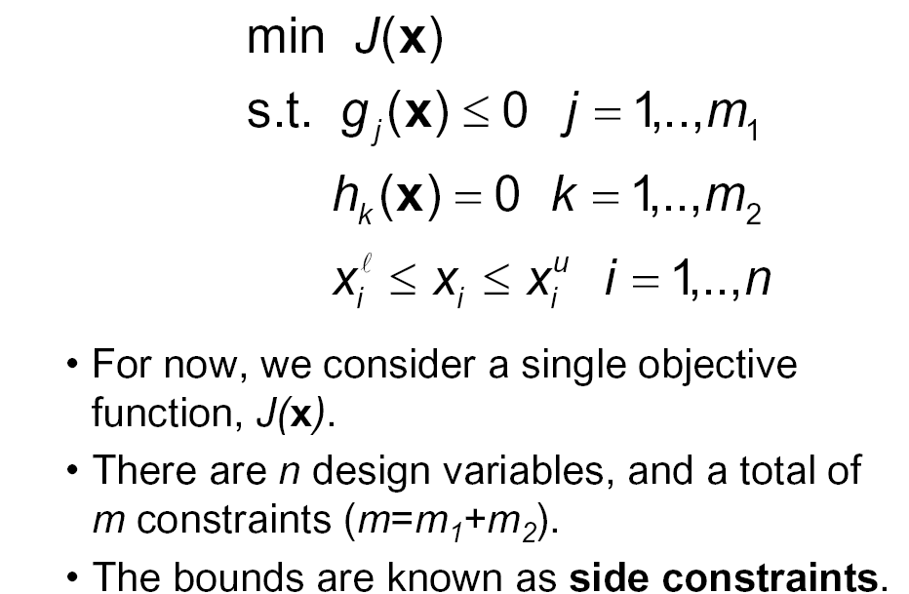
Basic Optimization Problem Definition
< n

Slide 4
OUTLINE
Preliminaries
Sufficient conditions for a local unconstrained minimum
Kuhn-Tucker conditions for a local constrained minimum
Classification of optimization problems and algorithms
Numerical methods for unconstrained optimization
Numerical methods for nonlinear programming
Numerical methods for discrete optimization
Multi-Objective Optimization (MOO)

Slide 5
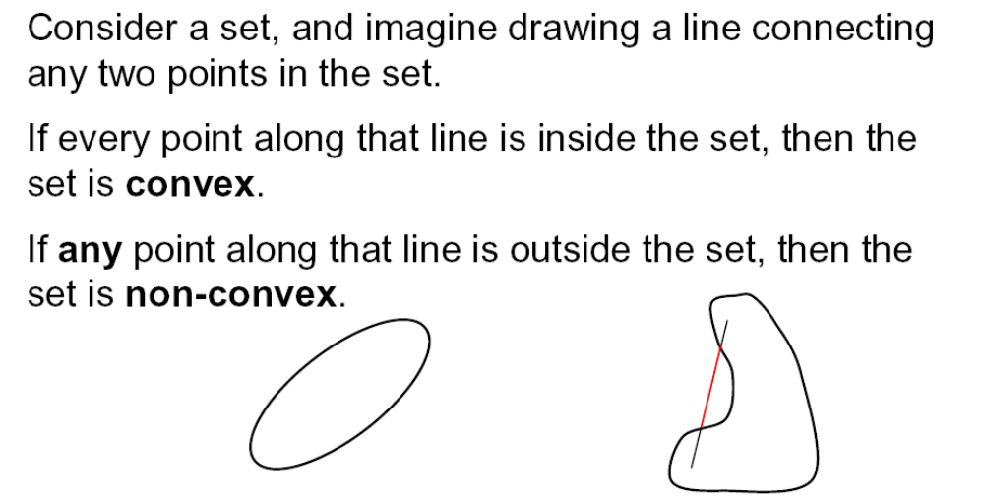
Preliminaries (1)
convex sets

Slide 6
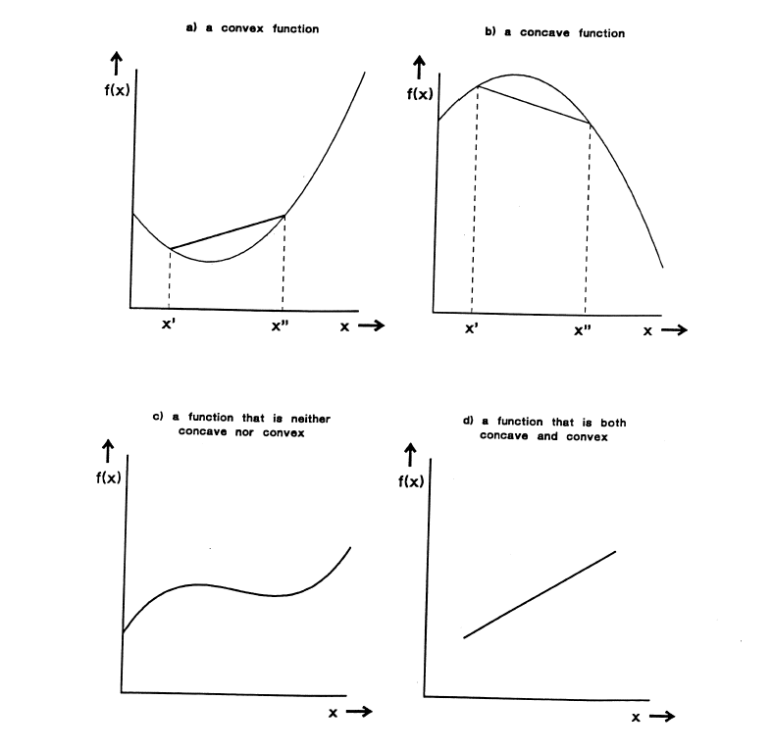
Preliminaries (2)
convex functions
convex
concave
convex…
…but not
strictly convex

Slide 7
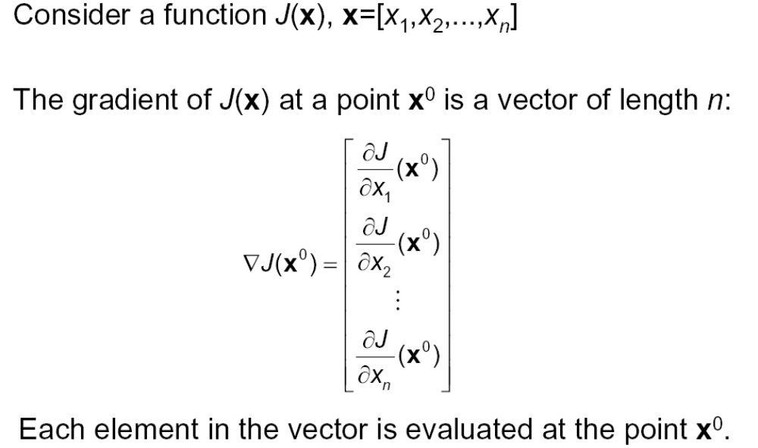
Preliminaries (3)
gradient vector

Slide 8
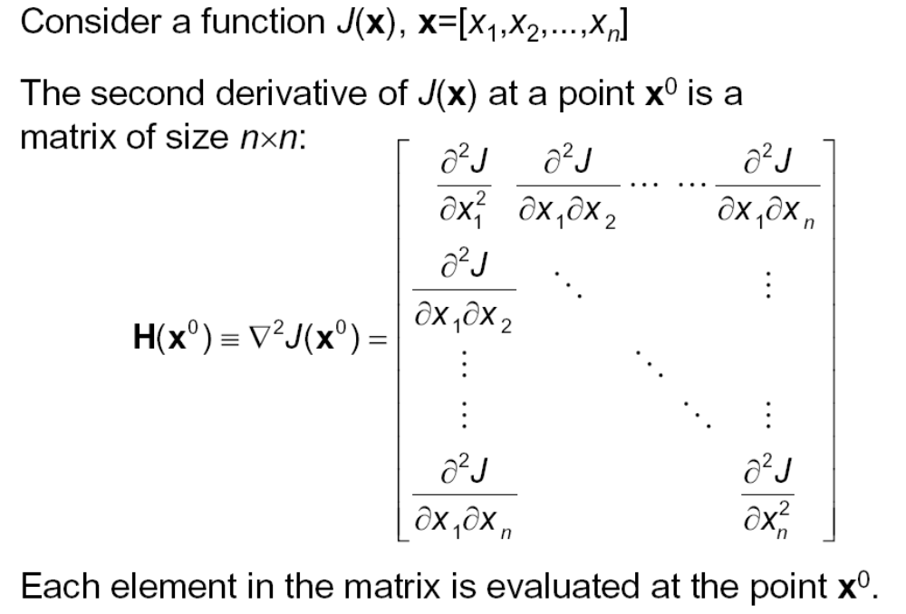
Preliminaries (4)
Hessian matrix

Slide 9
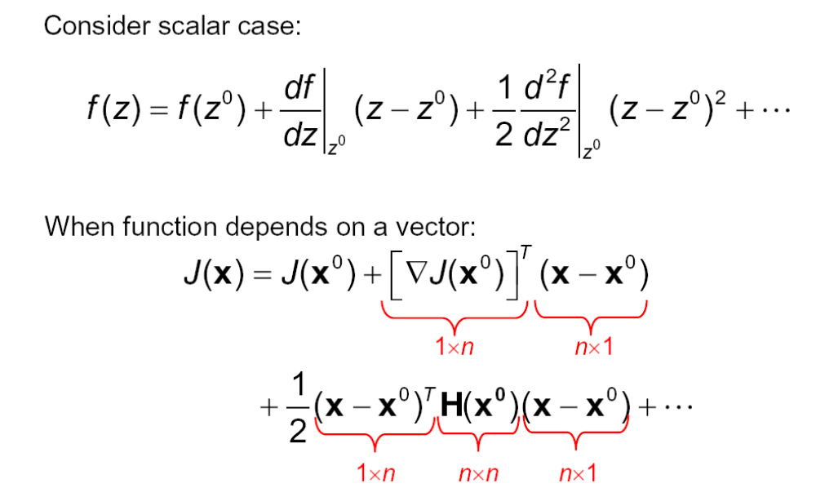
Preliminaries (5)
Taylor Series Expansion

Slide 10
Preliminaries (6)
positive-definite matrices
A symmetric Matrix H is said to be positive definite, if:
for all ∆x ≠ 0, ∆x^{T} H ∆x > 0
In shorthand we write H > 0.
A function f(x) is a strictly convex function only if its Hessian
matrix H(x) > 0, for all x.
A matrix H is readily tested whether it is positive definite by
checking that all of its eigenvalues are positive.

Slide 11
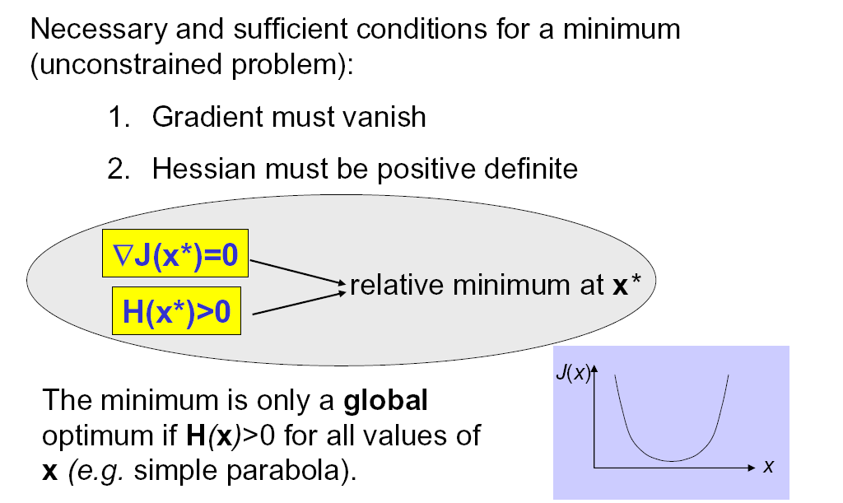
Sufficient conditions for a local minimum of an unconstrained optimization problem

Slide 12
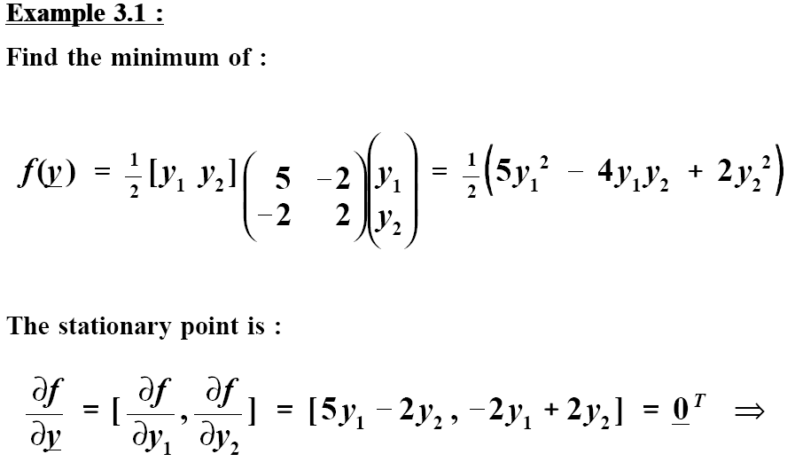

Unconstrained Nonlinear Optimization
Example
f(y)

Slide 13
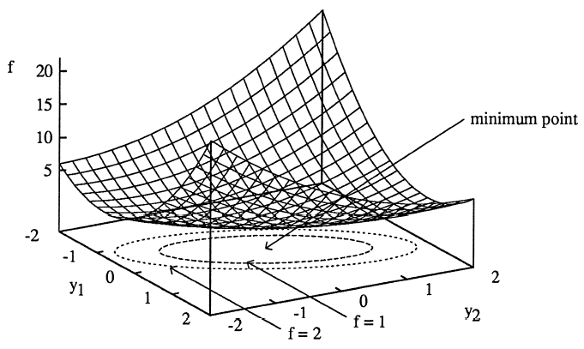
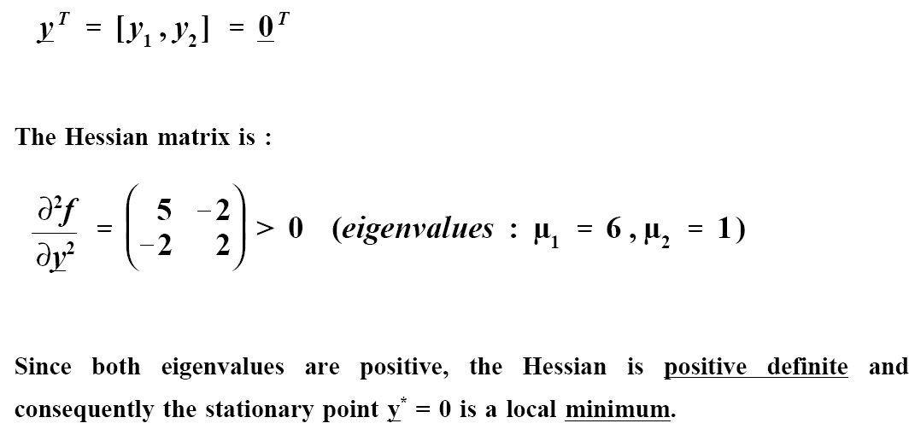
Example (continued)
H

Slide 14
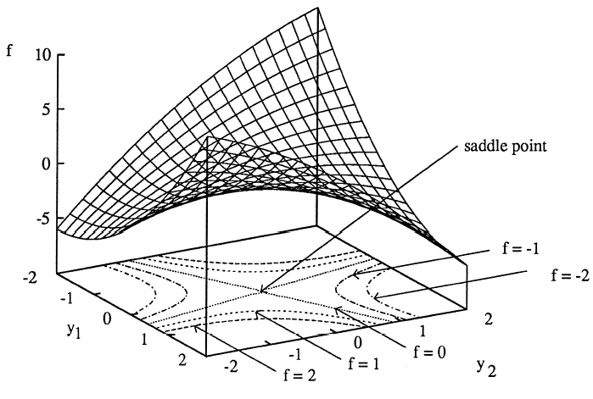
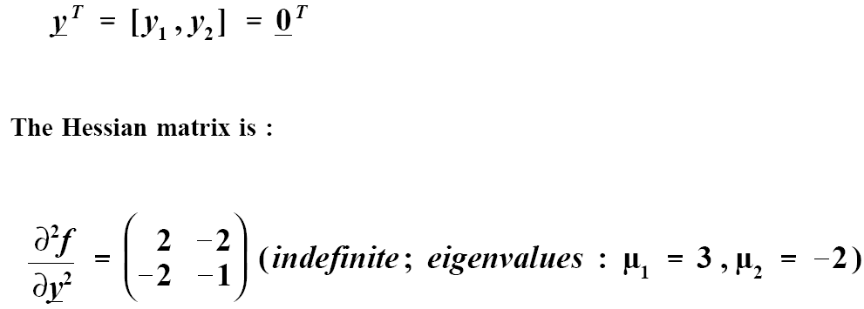
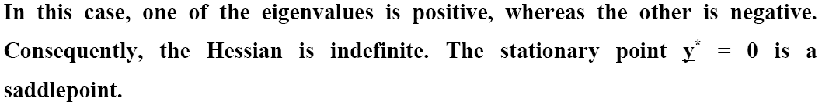
Example 2
f(y) = ½(2y₁² -4y₁y₂ –y₂²)

Slide 15
Basic constrained optimization problem
< n

Slide 16
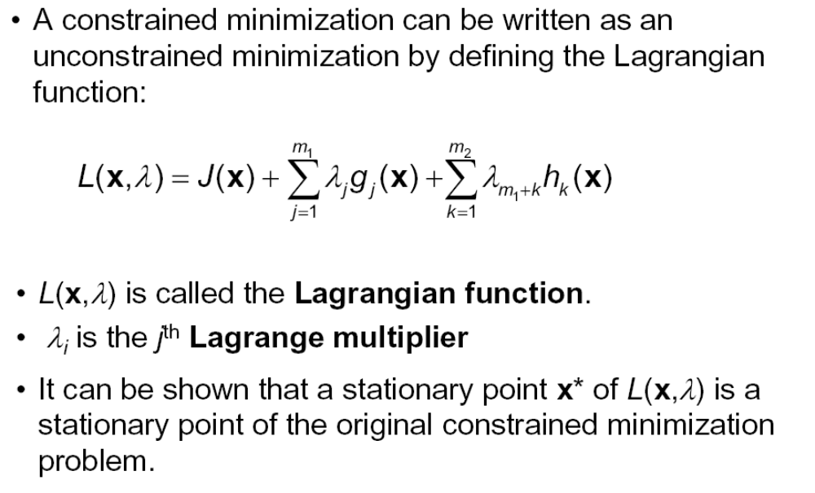
Constrained optimization: Lagrangian function

Slide 17
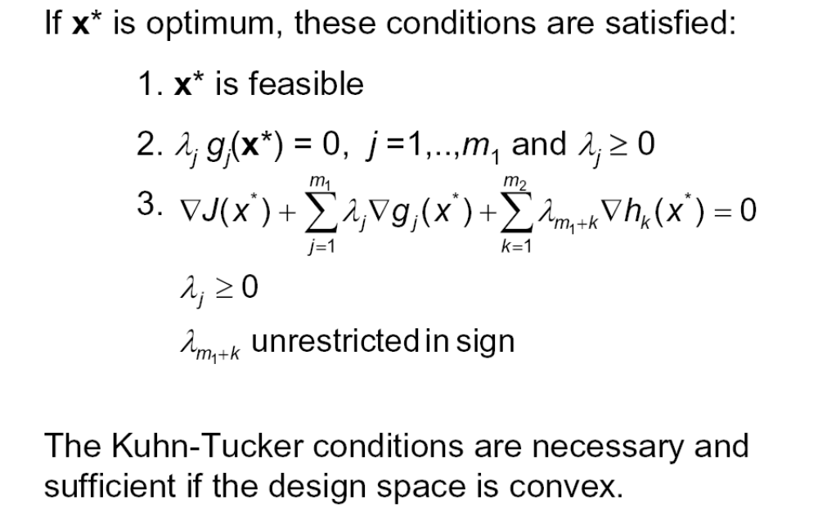
Constrained optimization:
Kuhn-Tucker (KT) conditions

Slide 18
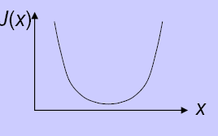
Nonlinear Constrained Optimization:
illustration KT conditions for inequality constraints
Example: minimize J = X² subject to,
g(X) = X - 1 ≤ 0 g(X) = X + 1 ≤ 0
J =0
J ≠ 0
interior minimum
boundary minimum
Set up a Lagrangian (augmented) function: L = J + λ.g ,
Set L = 0; require ≥ 0.
L = J + λ. g = 0 L = J + λ. g = 0
X* = 0 ; λ = 0 X* = -1 ; λ = 2 > 0
λ

Slide 19
Constrained Nonlinear Optimization:
convex design space
    The design space is convex if the objective function and all constraint surfaces are convex.
    If the design space is convex the Kuhn-Tucker conditions are sufficient to guarantee that x* is not only a local optimum but also a global optimum.
    Unfortunately, the design space is rarely convex.

Slide 20
How to select an optimization algorithm?
Number of design variables (problem size)
Type of design variables (real/integer, continuous/discrete)
Linear/non-linear
Convex/non-convex
Unconstrained/constrained (equality/inequality constraints)
Noisy data/non-smooth functions
Deterministic/stochastic
Local/global optimum
Exact/heuristic approach
Computational resources
Parallel processing

Slide 21
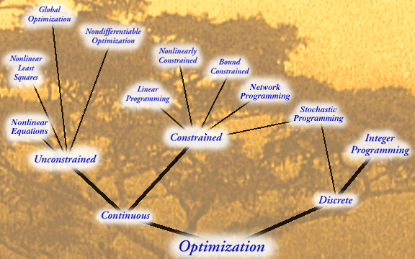
Optimization algorithm selection tree

Slide 22
Numerical methods for unconstrained nonlinear (local) optimization
Methods for nonlinear optimization can be roughly divided into :
(i) search methods (function evaluation only)
(ii) gradient methods (require gradient information and second order methods also Hessian information).
Most above methods iteratively search for the minimum, starting form an initial guess:
X^{q} = X^{q-1} + α^{q} . S^{q} ; f(X^{q}) = min f(X^{q-1} + α .S^{q} )
α
S^{q} : search direction in step k
α^{q} : 1-D search stepsize in step k

Slide 23
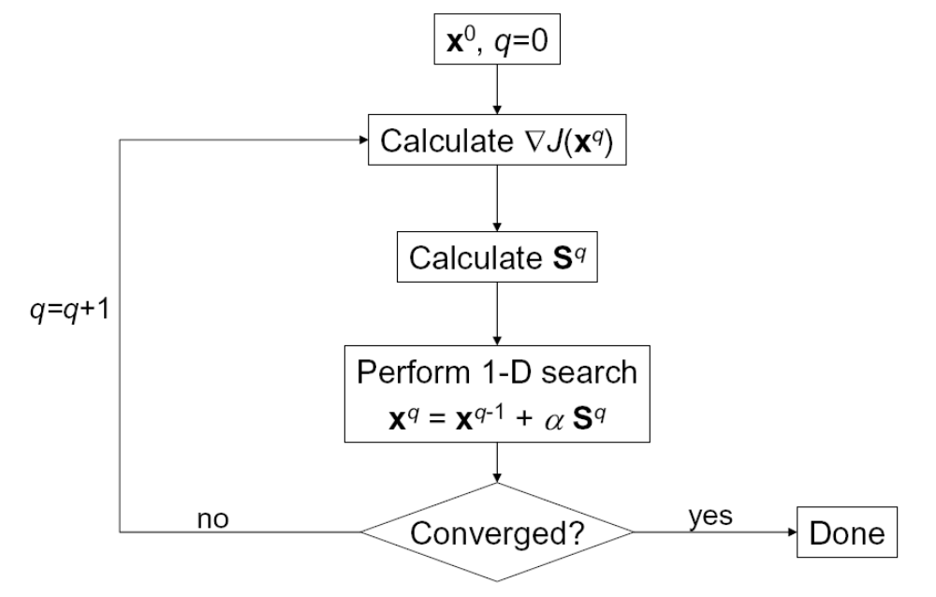
Optimization process gradient method
Search direction
Search stepsize

Slide 24
1-D optimization : line search methods
Determining the optimal step-size is called a "line search".
Line search methods that are typically employed in both search and gradient-based optimization include :
Fixed/variable step size methods
Interpolation methods
Fibonacci/Golden Section bracketing methods

Slide 25
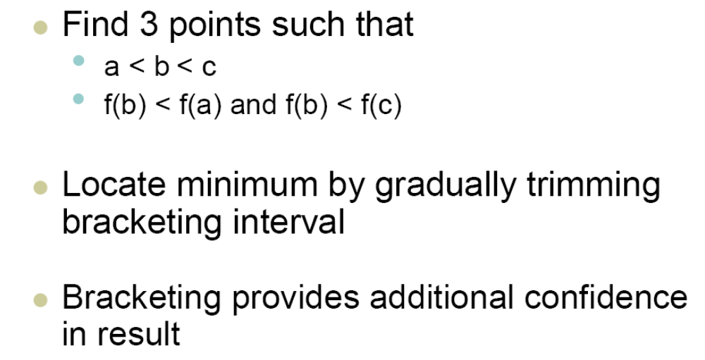
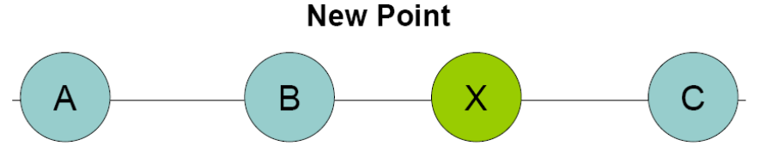
Line search : bracketing
(Golden Section/Fibonnaci method)
smart location choice for
new point X: Golden Section

Slide 26
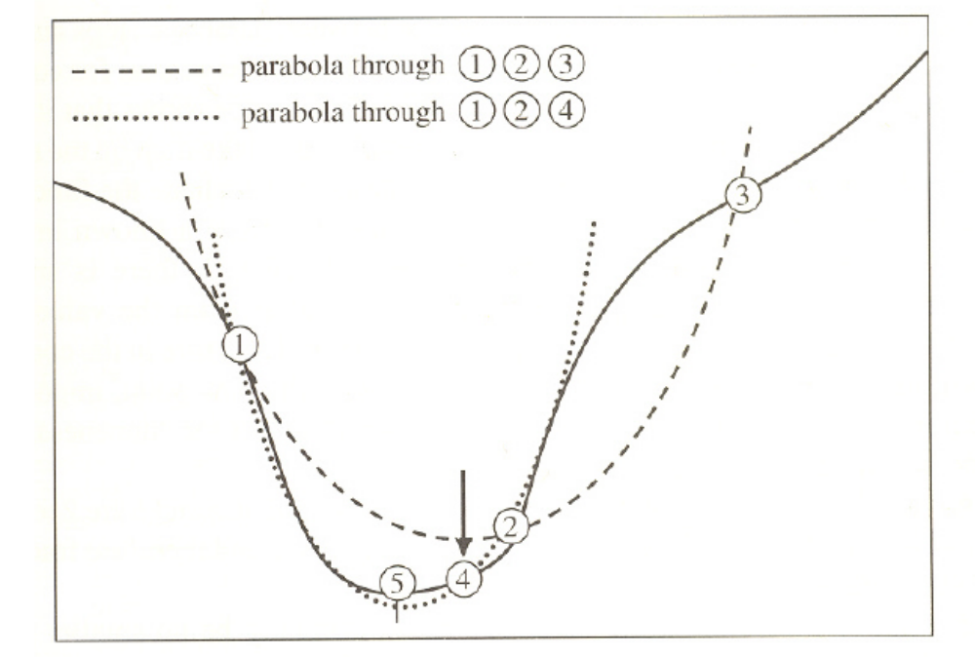
Line search : quadratic interpolation
original function f
Evaluate f
at point
x = -b/2a
approximating parabola
- Approximating parabola: f(x) = a.x² + b.x + c
Three points are needed in to determine coëfficiënts a,b,c
Minimum of parabola located at x = -b/2a

Slide 27
Search methods for unconstrained
non-linear optimization (zero-order methods)
Pattern search methods
Simplex method (Nelder & Mead)
Random search methods
Heuristic global optimization techniques, e.g.:
- genetic algorithms
- simulated annealing
- particle swarm optimization
- ant colony optimization
- tabu search
Note that an Heuristic is basically a rule of thumb that hopefully
will find a good answer.

Slide 28
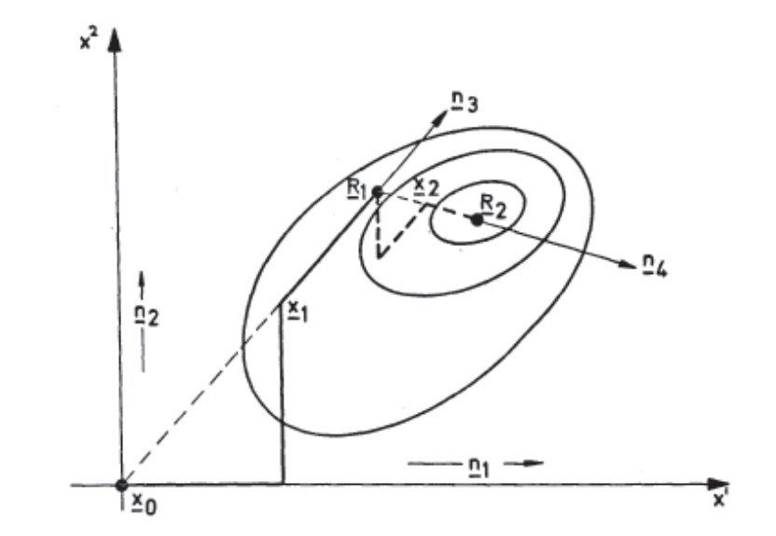
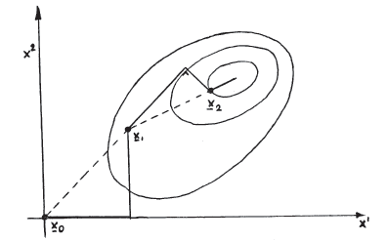
Search methods : pattern search
    Univariate search
    Hooke & Jeeves pattern search method
  Method of Powell
Method of Rosenbrock

Slide 29
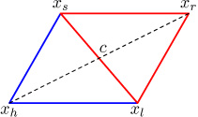
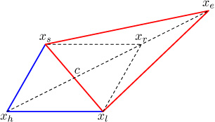
Search methods :
Nelder-Mead Simplex algorithm (1)
Example of optimization in 2D: simplex is triangle
Initial step - choose 3 points such that:
f(x_{l}) < f(x_{s}) < f(x_{h})
Move away from high point (reflection)
The point x_{r} is the default new point
,
If relection results in a new minimum f(x_{r}),
further move along the line x_{h} – x_{r}
(expansion)

Slide 30
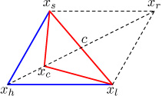
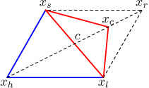
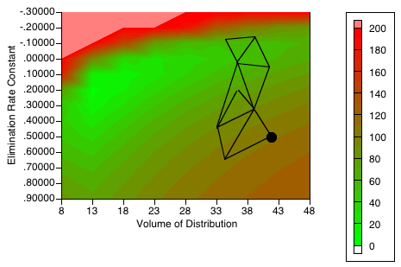
Search methods :
Nelder-Mead Simplex algorithm (2)
If relection not succesfull,
try a smaller step (contraction)
Method is robust, but may offer poor
convergence near optimum.
Method is typically used in low dimensional problems, with noisy data

Slide 31
Search methods:
Genetic Algorithm applied to discrete optimization (1)
Maximize: f = 500 - X² - Y² (fitness function),
where X and Y are integers, 0 ≤ X, Y ≤ 15
Obvious optimal solution: X* = Y* = 0
The GA starts with the selection of an initial generation of solutions (called individuals) that are represented as “chromosomes” that take the form of bit strings.
Here, the bit string comprises 8 bits, 4 for each variable, e.g.:
01100101 ; 0110 = 0.(2)³ + 1.(2)² + 1.(2)¹ + 0.(2)⁰
X Y = 0 + 4 + 2 + 0 = 6
0101 = 0.(2)³ + 1.(2)² + 0.(2)¹ + 1.(2)⁰
= 0 + 4 + 0 + 1 = 5

Slide 32
Example application of Genetic Algorithm (GA)
to discrete optimization (2)
Let’s assume, we have the following generation of 4 individuals:
01100101 ; X = 6, Y =5, F = 439
11011111 ; X = 13, Y = 15, F = 106
10010011 ; X = 9, Y = 3, F = 410
00110100 ; X = 3, Y = 4, F = 475
We now construct a “spinning wheel” with every individual taking up a part of the wheel proportional to its fitness-value F, and spin the wheel 4 times:
  4) 00110100 ; X = 3, Y = 4, F = 475
  01100101 ; X = 6, Y = 5, F = 439
  00110100 ; X = 3, Y = 4, F = 475
  3) 10010011 ; X = 9, Y = 3, F = 410
1
4
2
3

Slide 33
Example application of Genetic Algorithm (GA)
to discrete optimization (3)
Now let’s us say that the first two (relatively fit) individuals are directly passed on to the next generation. The last two individuals enter the cross-over (reproduction) phase.
In the cross-over, both individuals (parents) will be divided into two parts, at the same randomly selected place (here, between the 5th and 6th bit):
011
100
011
10010100
00110011
10010|011
00110|100
10010|
00110|
10010011
00110100
100
new children:
Now the tails are interchanged and two new individuals (offspring) will emerge.
Now the tails are interchanged and two new individuals (offspring) will emerge.

Slide 34
The next phase involves (single-parent, single-child) mutation. The probability of mutation is very small, typically around 0.1%.
Let us, assume that such a mutation takes place in the third bit of the first individual of the initial population:
The next generation is:
00110100 ; X = 3, Y =4, F = 475 (parent)
01000101 ; X = 4, Y = 5, F = 459 (mutated parent)
00110011 ; X = 3, Y = 3, F = 482 (child)
10010100 ; X = 9, Y = 4, F = 403 (child)
Example application of Genetic Algorithm (GA)
to discrete optimization (4)
01100101
01000101

Slide 35
Gradient methods for unconstrained
(local) non-linear optimization
Steepest descent (first-order)
Conjugate gradients (first order)
Newton methods (second-order)
Quasi-Newton methods

Slide 36
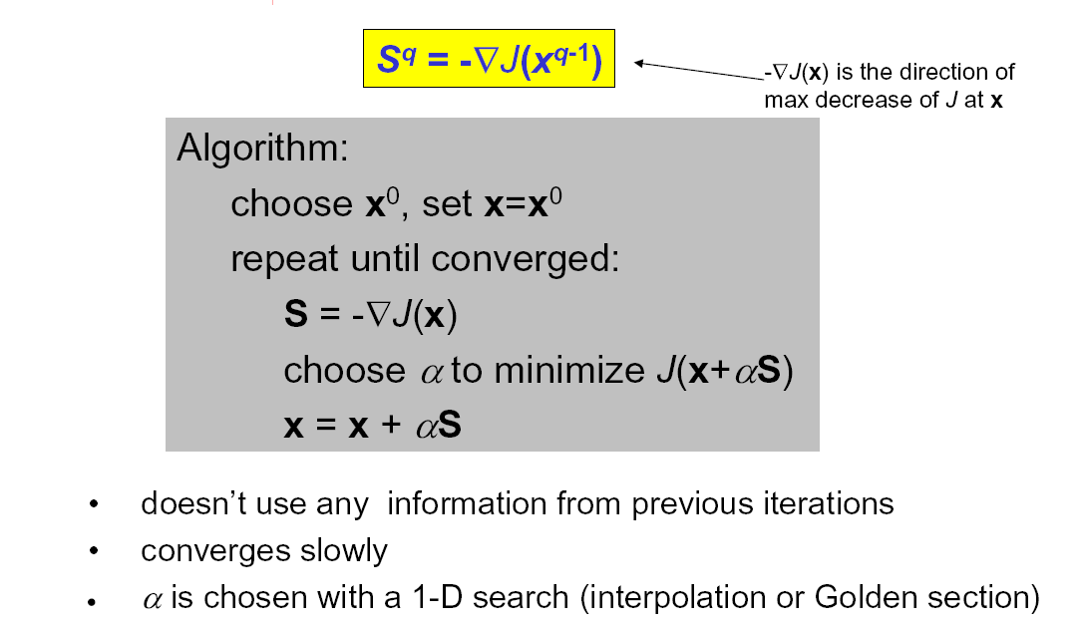
Steepest descent algorithm

Slide 37
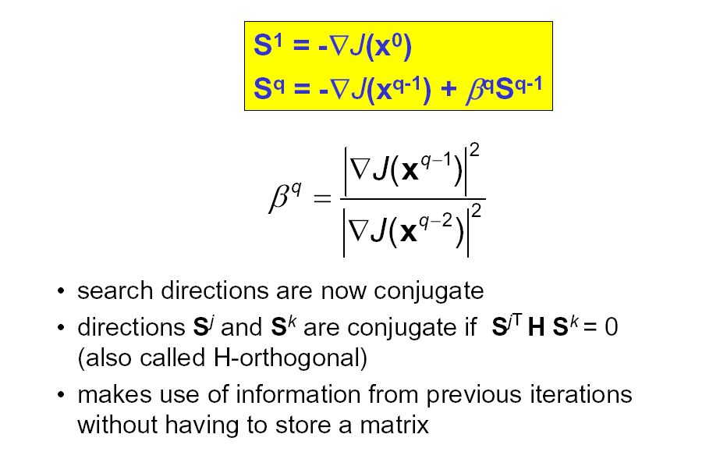
Conjugate gradient algorithm

Slide 38
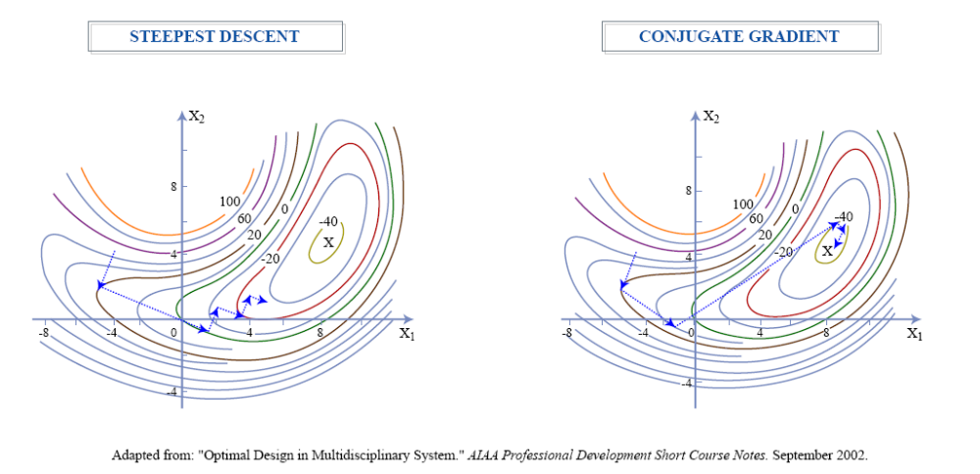
Convergence behavior Steepest Descent versus Conjugate Gradient approach

Slide 39
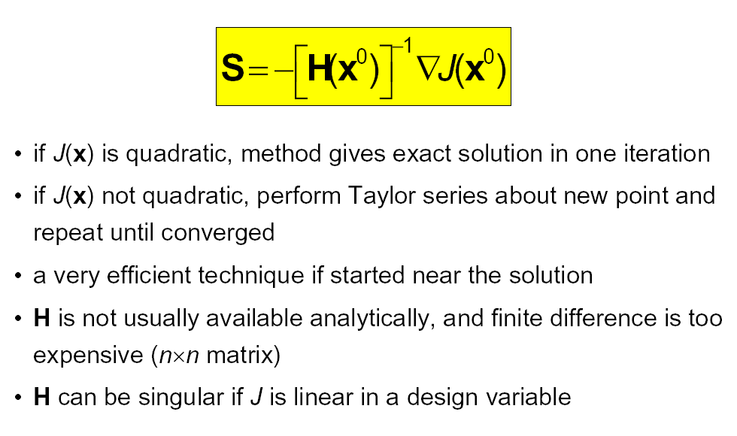
Newton’s method

Slide 40
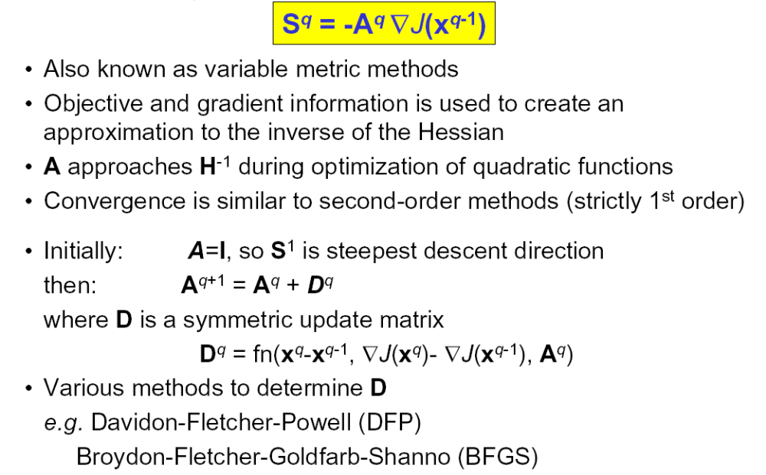
Quasi-Newton methods

Slide 41
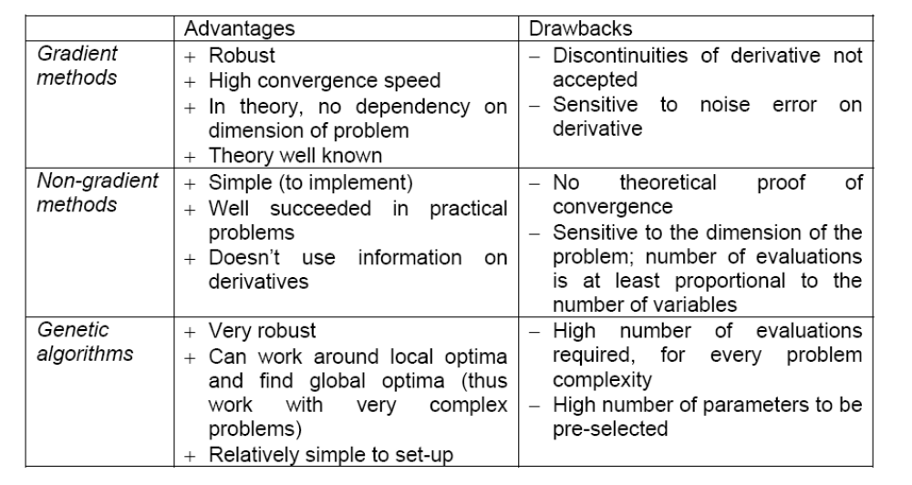
Pros and Cons of Various Optimization Methods

Slide 42
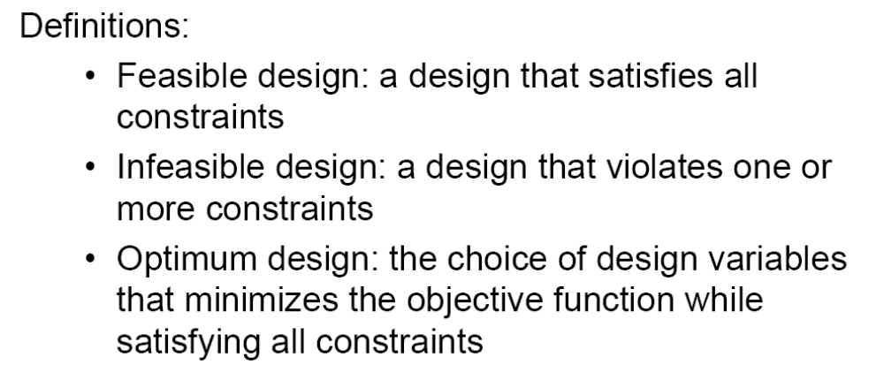
Constrained Nonlinear Optimization
In general, constrained optimization algorithms try to cast the
problem as an unconstrained optimization and then use one of
the algorithms out of that category.

Slide 43
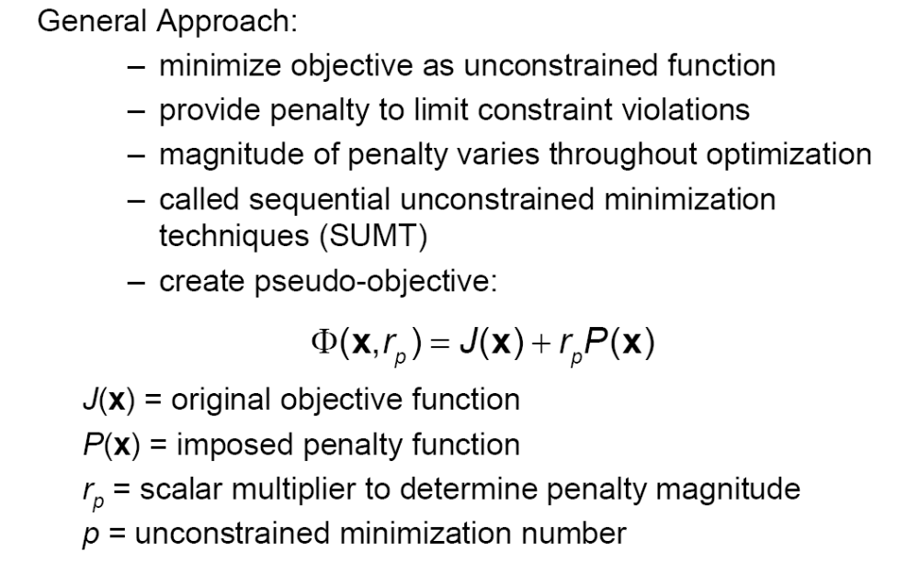
Constrained Nonlinear Optimization:
Penalty and Barrier Methods

Slide 44
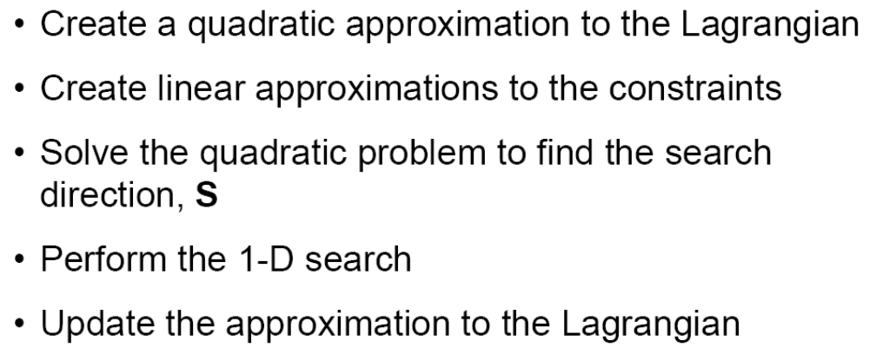
Constrained Nonlinear Optimization:
Sequential Quadratic Programming (1)

Slide 45
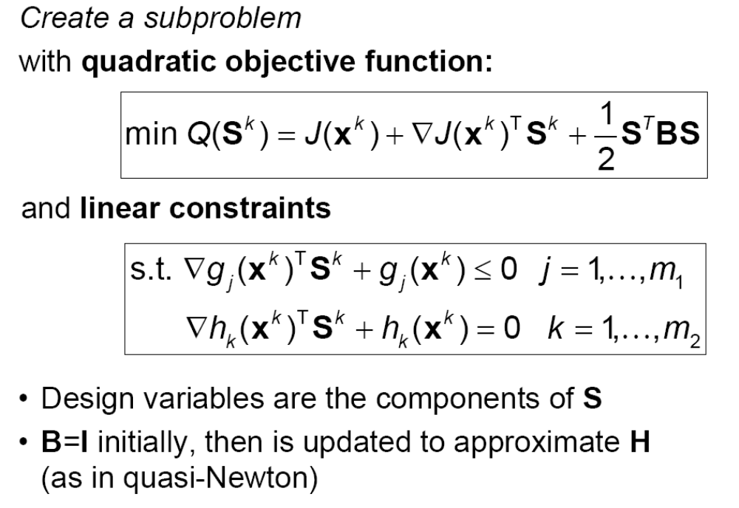

Sequential Quadratic Programming (2)
L
)

Slide 46
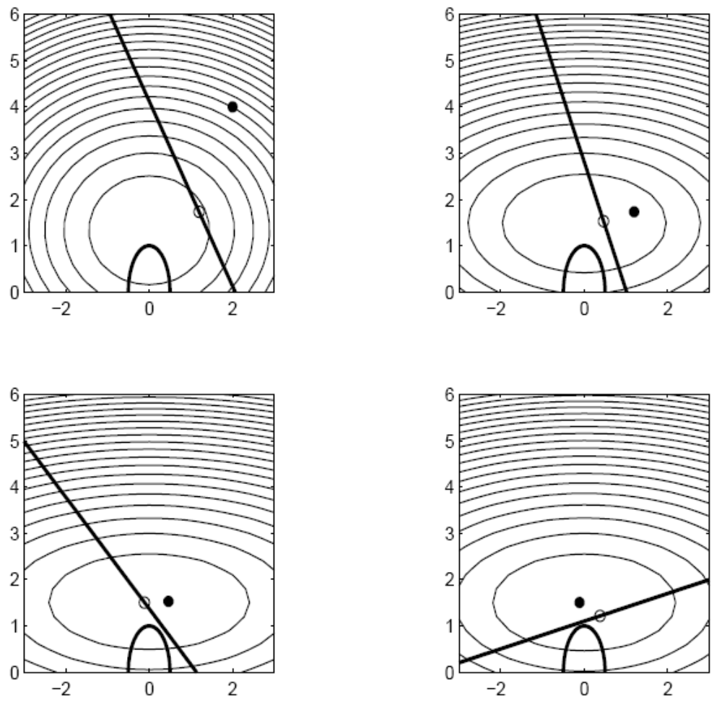
Sequential Quadratic Programming (3)
Contour of quadratic objective function
1
Locally linearized constraint
2
2
3
*
*
Optimum
Original non-linear constraint
Example featuring
4 SQP iterates
3
4
4
*
*
5

Slide 47
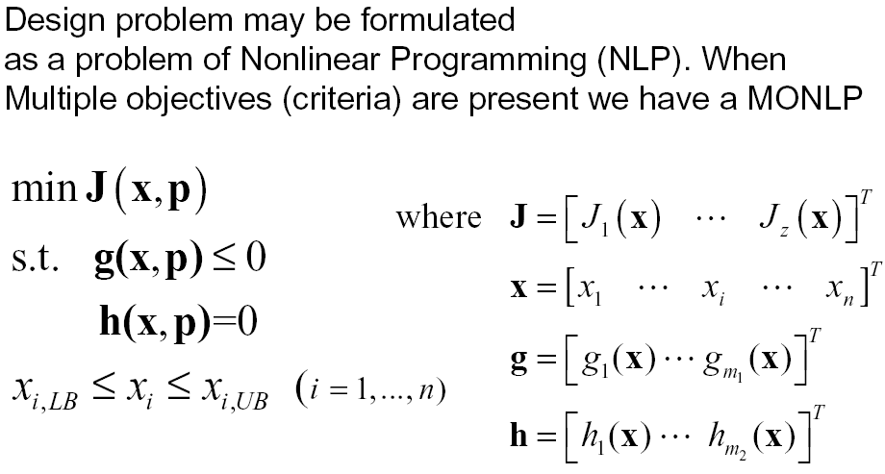
Multi-Objective Optimization Problem Definition

Slide 48
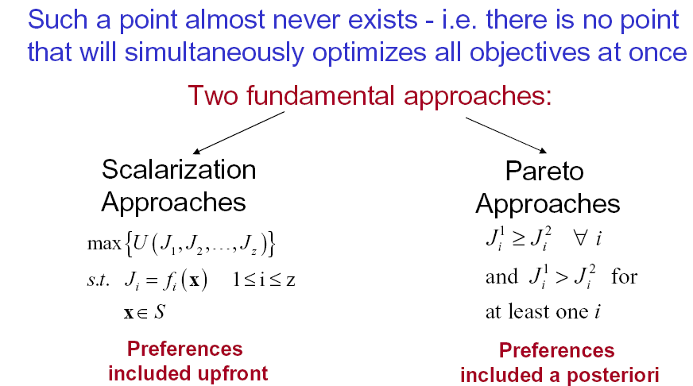
Multi-Objective Optimization (MOO) approaches
Proposition: find a point x* ∈S that simultaneously optimizes all objectives J_{i} , where 1 ≤ i ≤z

Slide 49
MOO Scalarization approach
In a scalarization approach, a multi-objective problem is modified
into a single-objective problem. Some of the techniques are:
Objective weighting: the objective functions J_{i} (x) are combined into a single objective function U = Σw_{i} J_{i} (x).
Goal programming: each of the objective functions is given a goal or target value to be achieved. Unwanted deviations from this set of target values are then minimized in a single achievement function (least squares).
Min-Max formulation: similar to goal programming. The maximum deviation from target value among all objective functions J_{i} (x) is minimized.

Slide 50
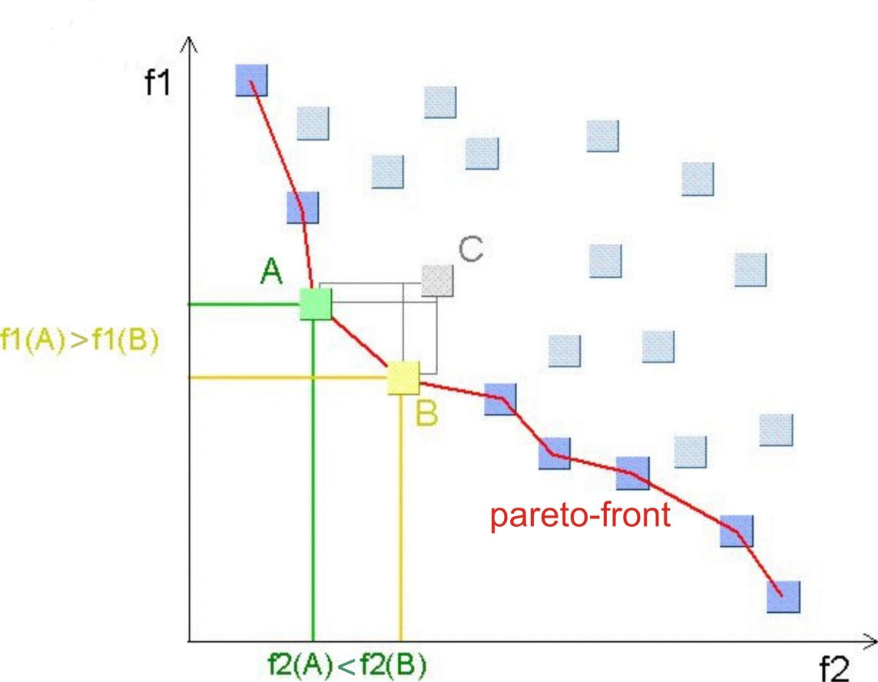
MOO Pareto Approach
Given a set of alternative design points, a change from one point to another that can make at least one individual better off without making any other individual worse off is called a Pareto improvement.
An allocation is Pareto efficient
or Pareto optimal when no
further Pareto improvements
can be made.
The Pareto frontier or Pareto set is the set of choices that are Pareto efficient

